Slide 1
Unit 6: Time Series
Non-Stationary Models
Signal + Noise
ARIMA
ARUMA

Slide 2
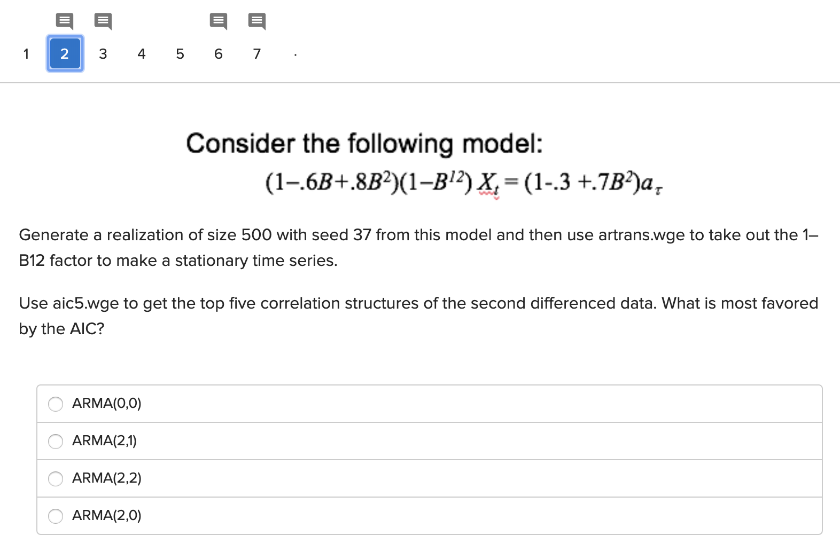
Concept Check … Checks

Slide 3
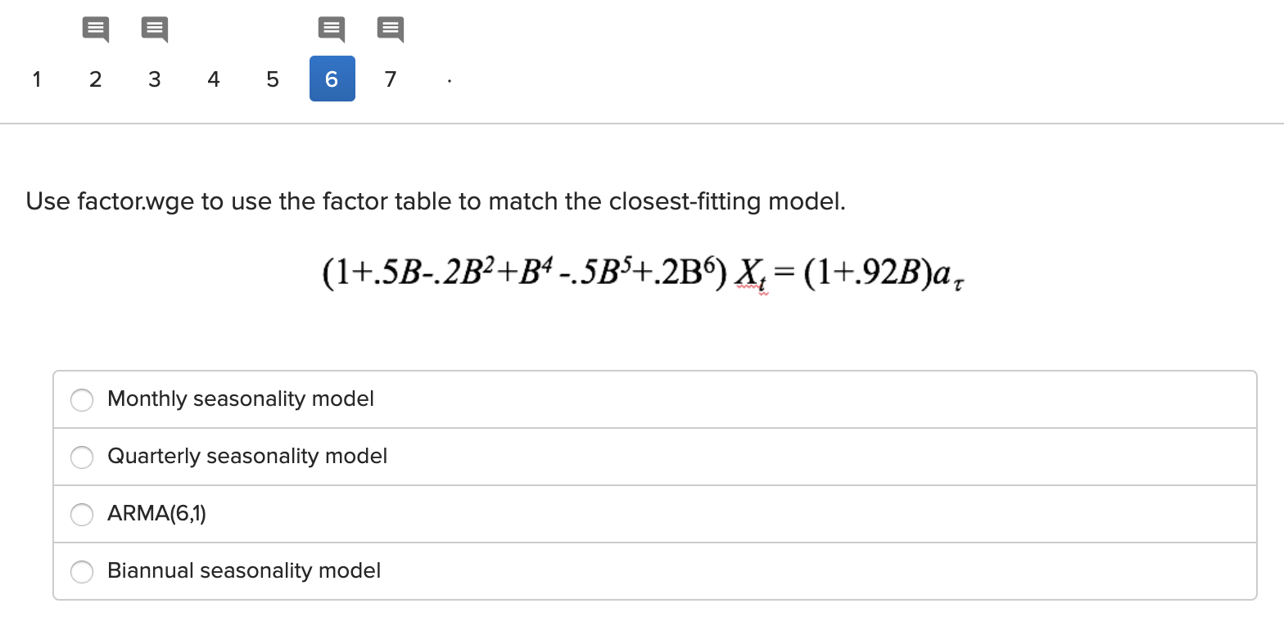
Concept Check … Check
s = 12 (common with Monthly Data.)
s = 4 common with Quarterly Data.
s = 2 (common with data collected semi -annually.)

Slide 4
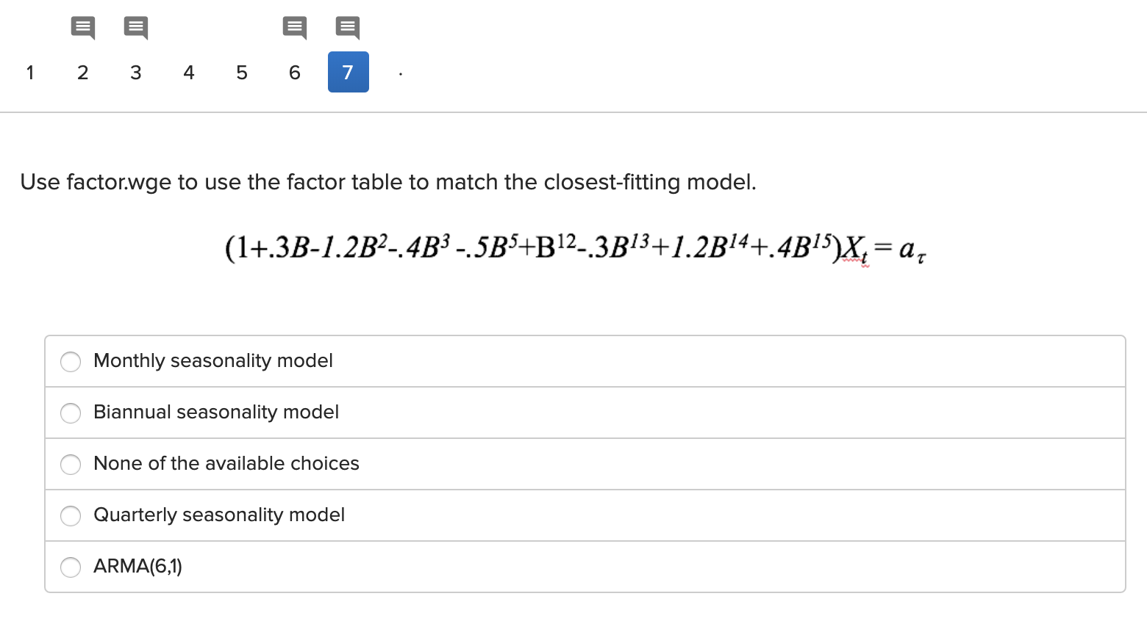
Concept Check … Check
s = 12 (common with Monthly Data.)
s = 2 (common with data collected semi -annually.)
s = 4 common with Quarterly Data.

Slide 5
A Different Order 15 Model
Consider the following model below and investigate if it is similar to a model with s ≠ 0. If so, which s seems most appropriate.
(-0.6996B -0.2599B² - 0.0079B³ + 0.0646B⁴ - 0.1381B⁵ + 0.0953B⁶ -0.0235B⁷ + 0.0969B⁸ -0.1770B⁹ +0.1191B¹⁰ -0.1030B¹¹ ⁻ 0.7754B¹² + 0.4590B¹³ + 0.4099B¹⁴ -0.0501B¹⁵)X_{t}=a_{t}
factor.wge(c(0.6996, 0.2599, 0.0079, -0.0646, 0.1381, -0.0953, 0.0235, -0.0969, 0.1770, -0.1191, 0.1030, 0.7754, -0.4590, -0.4099, 0.0501))

Slide 6
Pennsylvania Temperature Data dataset: patemp

Slide 7
Log Airline Data dataset: airlog

Slide 8
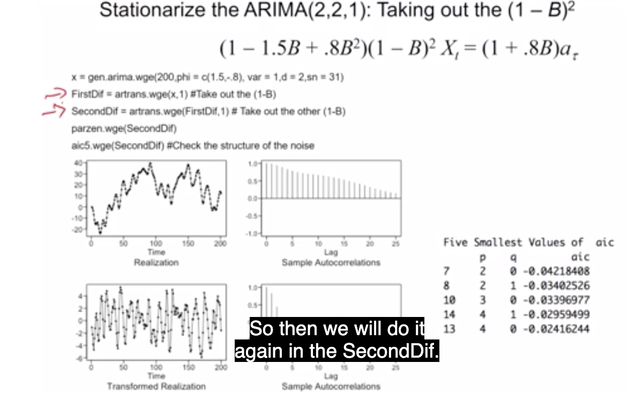
Try It Out!
Generate the data as it should be generated and then see which models the AIC favors.

Slide 9
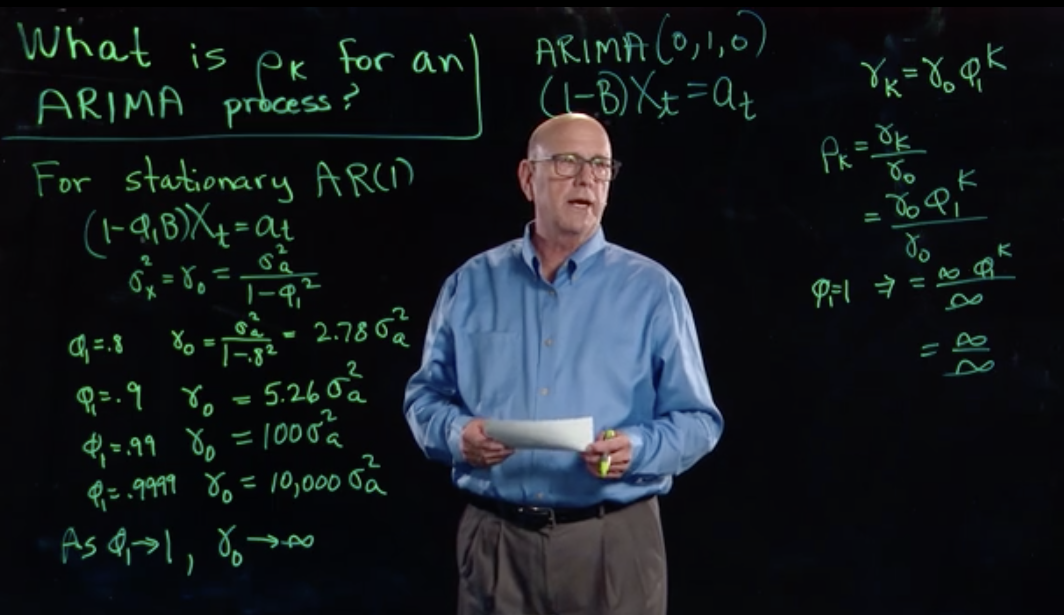
$σ_{x}^{2}v.σ_{a}^{2}$

Slide 10
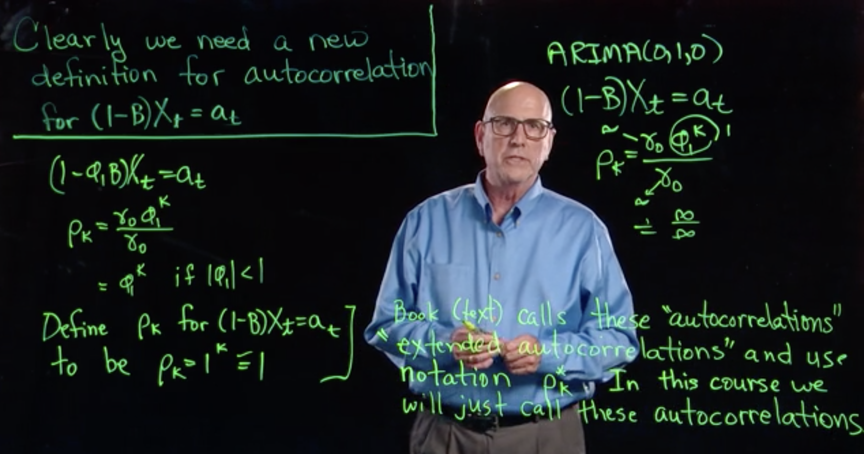
$ExtendedAutocorrelations$

Slide 11
Break Out 1
For each person in your group:
Remind everyone of your realization
Defend why you thought a signal + noise, ARIMA, ARUMA, ARMA, or any other model was appropriate or not appropriate.

Slide 12
End Break Out 1

Slide 13
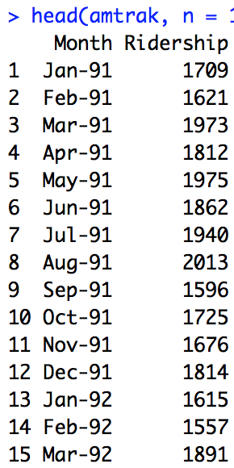
Monthly Amtrak Data

Slide 14
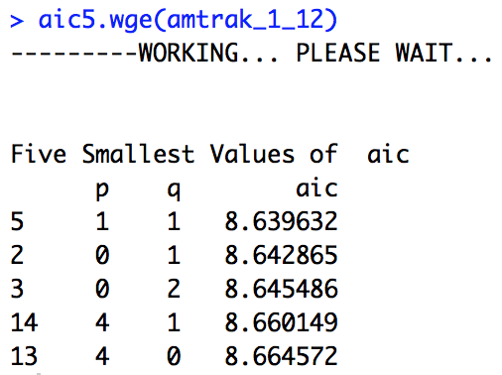
Monthly Amtrak Data
Given the several peaks in the spectral density and the intuitive presence of at least annual seasonality, the (1-B^12) factor was removed. At that point there was still significant wandering and some evidence of a (1-B) term in the acf therefore the (1-B) was taken out as well. At this point the realization looked stationary and the aic5.wge() favored the ARMA(1,1). For this reason, a reasonable model seemed to be the an ARUMA model with d = 1, s = 12, p = 1 and q = 1. This can be written as a ARIMA(1,1,1) with s = 12.

Slide 15
Break Out 2

Slide 16
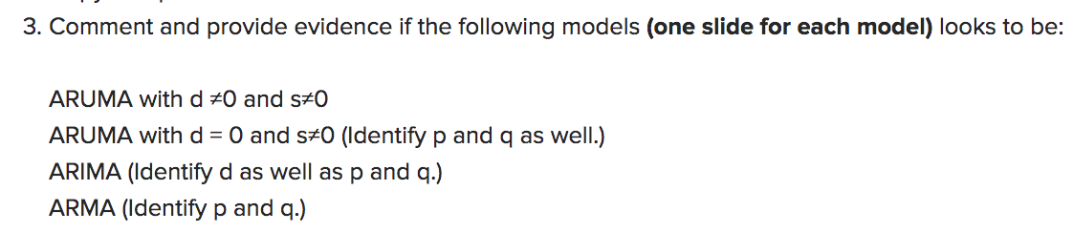
Break Out 2

Slide 17
Break Out 2

Slide 18
(1−B⁴) X_{t} = (1+.3B) (1−.6B+.8B²)a_{τ}

Slide 19
(1+.3B) X_{t} = (1−.6B+.8B²) a_{τ}

Slide 20
(1−.1B-.99B² +.013B³ +.2078B⁴ +.0888B⁵ +.00864B⁶)(1−B)²(1−B¹²) X_{t} = (1−.6B+.8B²)a_{τ}

Slide 21
Try a few more!

Slide 22
(1−.8B)(1−B)X_{t} = a_{t}

Slide 23
(1−.4B)(1−B)X_{t} = (1−.85B)a_{t}

Slide 24
(1−.4B)(1−B)(1−B⁴)X_{t} = (1−.85B)a_{t}

Slide 25
(1−.4B-.74B³)(1−.6B)(1−B)²(1−B¹²)X_{t} = (1−.85B²)a_{t}

Slide 26
Simply Judge From The Plots Just Speculate

Slide 27
Simply Judge From The Plots Just Speculate

Slide 28
End Break Out 2

Slide 29
Break Out 3

Slide 30
Stock Modeling
For each member of your group
Describe the stock you picked
Describe the analysis you performed to try and identify a model.

Slide 31
End Break Out 3

Slide 32
https://www.wsj.com/articles/sohn-stock-tips-may-not-be-worth-peanuts-1524592131

Slide 33
MO
getSymbols("MO", from = "2018-6-10", to = "2019-6-10", auto.assign = TRUE)
plotts.sample.wge(MO$MO.Close)
MO1 = artrans.wge(MO$MO.Close,1)

Slide 34
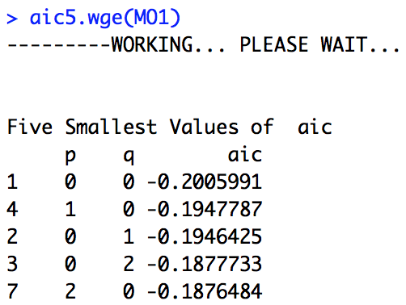
MO
MO1 = artrans.wge(MO$MO.Close,1)

Slide 35
Break Out 4

Slide 36
Break Out 4
Identify the seasonality if any:
(1−.76B - .94B⁴ +.75B⁵)X_{t} = a_{t}

Slide 37
Which Model has most evidence of s = 12
Model 1
(-0.1B - 0.72B² + 0.016B³ + 0.29B⁴ - 0.02B⁵ - 0.144B⁶ + 0.0032B⁷ - 0.0621B⁸ + 0.008B⁹ + 0.058B¹⁰ - 0.00128B¹¹ - 0.0072B¹²)Xt = at
# This will help:
c(0.1, 0.72, -0.016, -0.29, 0.02, 0.144, -0.0032, 0.0621, -0.008, -0.058, 0.00128, 0.0072)
Model 2
(.2B + 0.63B² - 0.97B¹² - 0.1940B¹³ + 0.6111B¹⁴)Xt = at
# This will help:
c(-0.2000, 0.6300, 0.0000, 0.0000, 0.0000, 0.0000, 0.0000, 0.0000, 0.0000, 0.0000, 0.0000, 0.9700, 0.1940, -0.6111)

Slide 38
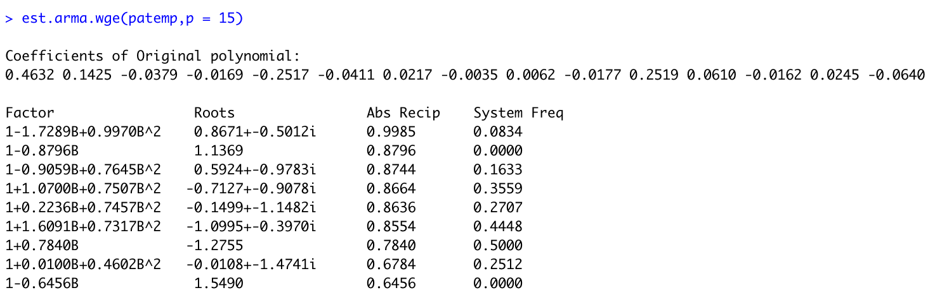
Pennsylvania Temperature Data
This is a an AR(15) that was fit to the Penn. Temperature data.
What do you think about a (1 – B¹²)?

Slide 39
End Break Out 4

Slide 40
Nyquist Frequency Discussion
#Nyquist Frequency
## Data Generation
We have generated data that has a frequency on the scale of seconds of .02. That is, the data have a period of 50 seconds.
We have then sampled only at every minute (every 60th observation). Note that this has a frequency around .2.
```{r}
library(tswge)
P02 = gen.sigplusnoise.wge(6000,coef = c(1,0), freq = c(.02,0), vara = 0)
parzen.wge(P02)
x = seq(1,6000, by = 60)
Min = P02[x]
parzen.wge(Min)
par(mfrow=c(1,2))
parzen.wge(P02)
parzen.wge(Min)
```
## Scenario
Consider now that the data we observed first was the data observed at every minute. We would then see a frequency of about .2.
```{r}
parzen.wge(Min)
```
However, there was another frequency present but we could not observe it ... unless we sample faster.
The P02 data is the data that was then recorded at the seconds. Each 60th data point is the same as the Minute data ... but there is a much different frequency present now. Now each integer represents a second.
```{r}
parzen.wge(P02)
```

